Slide 1

Advanced Topics
Web Host, Logging, Cache, Sessions, TempData, Areas,
Performance, SEO, GDPR
SoftUni Team
Technical Trainers
Software University
https://softuni.bg

Slide 2
Table of Contents
WebHost
Logging
Cache
Sessions
TempData
Areas
Performance
SEO
GDPR

Slide 3
Have a Question?
sli.do #csharp-web

Slide 4



WebHost
...and WebApplication

Slide 5
WebHost
ASP.NET Core apps configure and launch a host
The host is responsible for app startup and lifetime management
At minimum, the host configures a server and request pipeline
Can also set up logging, dependency injection and configuration

Slide 6
WebApplication
Before .NET 6, the webhost is set up first and then the app is built
In .NET 6 we do those actions simultaneously in Program.cs
WebApplication is an abstraction of WebHost
Returned by the Build() method of the WebApplicationBuilder
Defines the way the app communicates with its environment

Slide 7
CreateBuilder()
CreateBuilder() initializes a new instance of the WebApplicationBuilder class
Performs several essential tasks
Configures Kestrel server, loads host and app configuration
Configures logging, IIS integration, sets the content root, etc.
This sets up default config which you can modify:
var builder = WebApplication.CreateBuilder(args);
builder.Host.ConfigureServices((context, services) =>
{
services.Configure<KestrelServerOptions>(
context.Configuration.GetSection("Kestrel"));
});
builder.Host.ConfigureLogging(logging =>
{
logging.SetMinimumLevel(LogLevel.Warning);
});

Slide 8

Logging
ILoggerFactory & ILogger

Slide 9
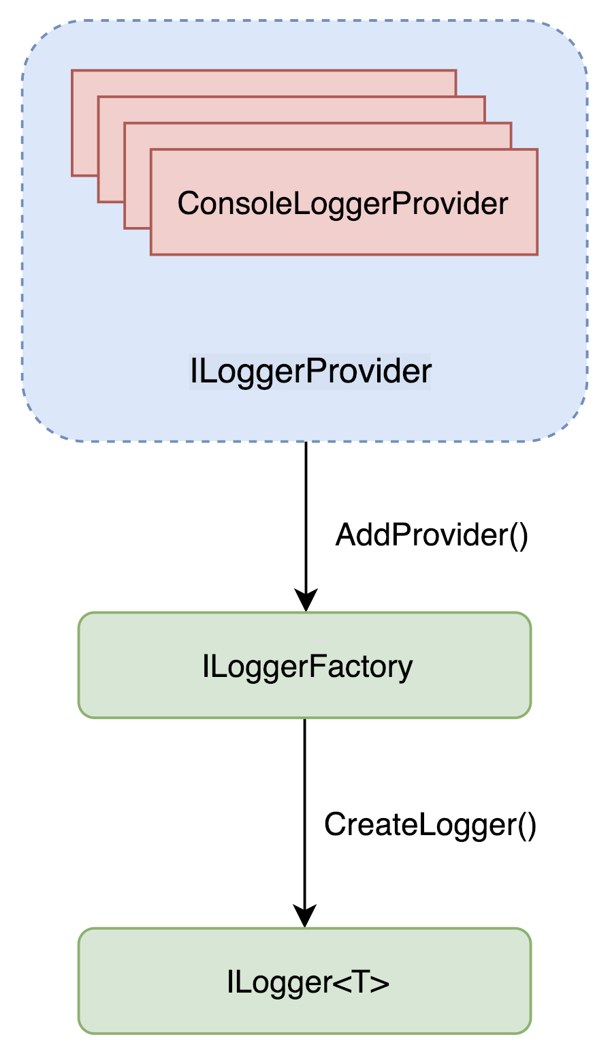
Logging
ASP.NET Core supports a logging API
It works with a variety of logging providers
The ASP.NET Core logging infrastructure consists of 3 main components:
ILogger – used by the app to create log messages
ILoggerFactory – creates instances of ILogger
ILoggerProvider – controls where log messages are output
An application may have multiple logging providers

Slide 10
ILogger, ILoggerFactory and ILoggerProvider
AddConsole()
ILoggerProviders are registered with the ILoggerFactory
Ilogger Providers are used to create loggers that output to a specific destination
ConsoleLoggerProvider
AddFile()
FileLoggerProvider
Injecting an ILogger into a class creates a logger that wraps each of the provided logger types
ILoggerFactory
ConsoleLogger
CreateLogger()
FileLogger
ILogger

Slide 11
Logging Configuration
Logging configuration is commonly provided by the app settings
Logging property can have LogLevel
LogLevel specified the minimum level to log
Other properties under Logging can specify logging providers
Sample Logs
appsettings.json
{
"Logging": {
"LogLevel": {
"Default": "Warning"
}
},
...
}
info: TodoApi.Controllers.TodoController[1002]
Getting item 0
warn: TodoApi.Controllers.TodoController[4000]
GetById(0) NOT FOUND

Slide 12
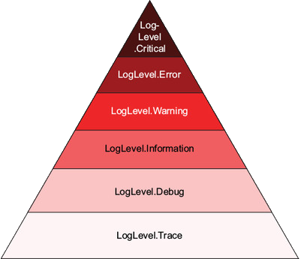
Logging Levels
Logging Levels are not technology-specific
It is important to know the levels and their use
Logging Levels and their description:
Trace – for information, valuable only for debugging
Debug – for information, useful in development and debugging
Information – for tracking the general flow of the app
Warning – for abnormal and unexpected events in the app flow
Error – for errors and exceptions that cannot be handled
Critical – for failures that require immediate attention

Slide 13
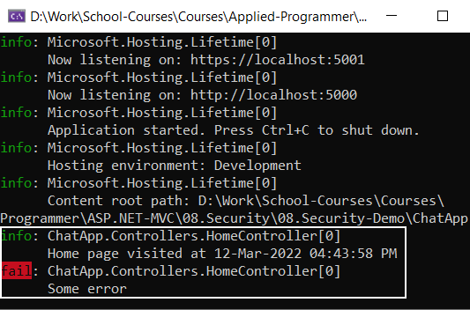
How to Log Messages from Your Code?
public class HomeController : Controller
{
private readonly ILogger<HomeController> logger;
public HomeController(ILogger<HomeController> logger)
=> this.logger = logger;
public IActionResult Index()
{
var message = $"Home page visited at {DateTime.Now}";
this.logger.LogInformation(message);
var error = "Some error";
this.logger.LogError(error);
return View();
}
}
Inject ILogger through the constructor
Messages are displayed on the console

Slide 14

Cache
An Efficient Way to Store Data

Slide 15


Cache
Cache makes a copy of a piece of data and stores it
Can be extracted much faster than from its original source
Significantly improves application performance
Works best with data that does not change frequently
App
Response 1
Request 1
DB
Response 2
Request 2
Response 3
Request 3
Cache

Slide 16
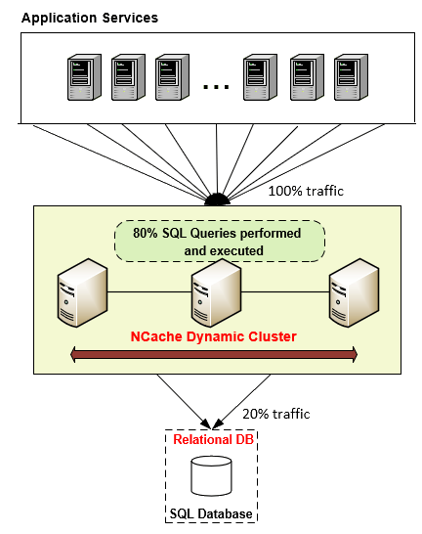
Cache Types
ASP.NET Core supports several different caches
The simplest cache is based on the IMemoryCache
An in-memory cache stored on the app server's memory
Can store any type – primitive or complex (object)
IDistrubutedCache – cache shared by multiple app servers

Slide 17



In-Memory Cache
In-memory Cache is configured as a simple service
// Add the IMemoryCache as a dependency to the DI
builder.Services.AddMemoryCache();
public class HomeController : Controller
{
private IMemoryCache cache;
public HomeController(IMemoryCache memoryCache)
{
// Inject the IMemoryCache through DI
this.cache = memoryCache;
}
...
}

Slide 18
In-Memory Cache – Example
Here is an example of a cache DateTime value
public IActionResult GetCachedData()
{
DateTime cacheEntry;
if (!this.cache.TryGetValue(CacheKeys.Entry, out cacheEntry)) // Look for cache key.
{
cacheEntry = DateTime.Now; // Key not in cache, so get data.
var cacheEntryOptions = new MemoryCacheEntryOptions() // Set cache options.
.SetSlidingExpiration(TimeSpan.FromSeconds(3)); // Keep in cache for this time.
// Reset time if accessed.
// Save data in cache.
this.cache.Set(CacheKeys.Entry, cacheEntry, cacheEntryOptions);
}
return View("Cache", cacheEntry);
}

Slide 19


In-Memory Cache – Example (2)
The cached DateTime value remains in the cache
Its value is untouched, from the moment of caching
There are requests within the timeout period
No eviction is done due to memory pressure
<h3>Current Time: @DateTime.Now.TimeOfDay.ToString()</h3>
<h3>Cached Time: @(Model == null
? "No cached entry found"
: Model.Value.TimeOfDay.ToString())
</h3>

Slide 20
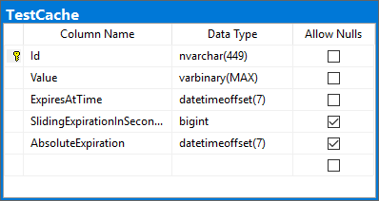
Distributed Cache
We can persist cache data in a SQL server database
builder.Services.AddDistributedSqlServerCache(
options =>
{
options.ConnectionString = Configuration.GetConnectionString("DefaultConnection");
options.SchemaName = "dbo";
options.TableName = "TestCache";
});
// services.AddDistributedRedisCache()
builder.Services.AddSession();
The cache table is created using the sql-cache command
dotnet sql-cache create "Data Source=(localdb)\\mssqllocaldb;Initial Catalog=DistCache;Integrated Security=True;" dbo TestCache

Slide 21
Cache Tag Helpers
The framework also supplies you with a convenient Tag Helper
The Cache Tag helper caches content to the internal cache provider
<cache>
Current Time: @DateTime.Now
</cache>
<cache expires-on="new DateTime(2025,1,29,17,02,0)">
Current Time: @DateTime.Now
</cache>
<cache enabled="true">
Current Time: @DateTime.Now
</cache>
<cache expires-after="TimeSpan.FromSeconds(120)">
Current Time: @DateTime.Now
</cache>
<cache expires-sliding="TimeSpan.FromSeconds(60)">
Current Time Inside Cache Tag Helper: @DateTime.Now
</cache>

Slide 22
HTTP Response Cache (1)
There are other types of Cache, like HTTP-based Response Caching
The primary HTTP header for caching is Cache-Control
It is used to specify caching directives
These directives control caching behavior during communication
Response Caching in ASP.NET Core is controlled by a simple middleware
builder.Services.AddResponseCaching();
app.UseResponseCaching();

Slide 23


HTTP Response Cache (2)
Once enabled, you can configure it:
Manually in Request Handlers
With attributes on Controller Actions
The convenient built-in ResponseCache attribute is quite useful
The attribute's properties are used to configure the Caching
[ResponseCache(Duration = 30, Location = ResponseLocation.None, NoStore = true)]
public IActionResult Error()
{
...
}

Slide 24
Sessions
Application state

Slide 25
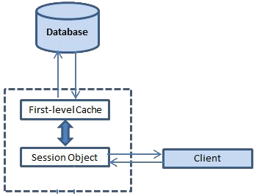
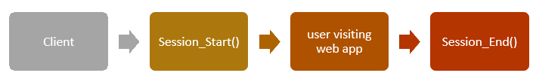
Sessions
Session state is an ASP.NET Core scenario for storage of client data
Each client has a unique Session ID which the framework stores
Data can be maintained while the client browsers the application
Session data is backed by cache, and is considered ephemeral
The application should
continue to function without session data

Slide 26
Configure Session
Enabling Session middleware, setting up in-memory session provider
// services.AddMemoryCache(); // Default in-memory cache – provides IMemoryCache
// Provides IDistributedCache
builder.Services.AddDistributedMemoryCache();
builder.Services.AddSession(options =>
{
// Set a short timeout for easy testing options.IdleTimeout = TimeSpan.FromSeconds(10);
// XSS security
options.Cookie.HttpOnly = true;
});
builder.Services.AddControllersWithViews();
// UseSession() Middleware must be called before UseMvc()
app.UseSession();

Slide 27
Set and Use Session
After the Session state is configured, HttpContext.Session is available
ASP.NET Core Sessions store byte array values to ensure serialization
You may need specific approaches in order to store complex data
public IActionResult GetShoppingCart()
{
if (this.HttpContext.Session.Get("Cart") == null)
{
this.HttpContext.Session.SetString("Cart", JsonConvert.SerializeObject(new Cart()));
}
this.ViewData["Cart"] = this.HttpContext.Session.GetString("Cart") == null
? null
: JsonConvert.DeserializeObject(this.HttpContext.Session.GetString("Cart"));
return View();
}

Slide 28
Extend Session
You can implement Session Extension methods to ease your work
public static class SessionExtensions
{
public static void Set<T>(this ISession session, string key, T value)
{
session.SetString(key, JsonConvert.SerializeObject(value));
}
public static T Get<T>(this ISession session, string key)
{
var value = session.GetString(key);
return value == null ? default(T)
: JsonConvert.DeserializeObject<T>(value);
}
}

Slide 29
Temp Data
Store data until it’s read

Slide 30
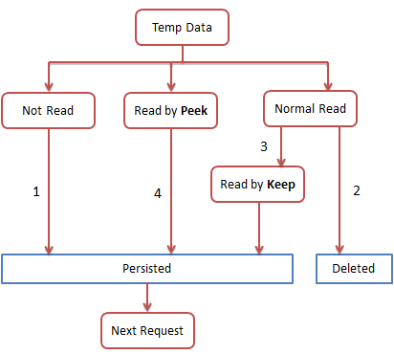
TempData
ASP.NET Core exposes the TempData property in:
Razor Page page models
MVC Controllers
The property stores data until it's read
Keep() and Peek() methods avoid deletion when data is examined
TempData is:
Particularly used for redirection
When data is required for more than a single request

Slide 31

TempData
TempData is implemented by TempData providers
Using either cookies or session state
Since ASP.NET Core 2.0, the default TempData provider is cookie-based
builder.Services.AddControllersWithViews()
.AddSessionStateTempDataProvider();
builder.Services.AddSession(...);
. . .
app.UseSession();
Not needed when working with cookies
Not needed when working with cookies
Not needed when working with cookies

Slide 32
TempData with Cookies Workflow
User
Server
Database
POST
SELECT
Redirect 302 Temp Data Cookie
Store Temp Data
RESULT
GET Temp Data Cookie
UPDATE
Get Temp Data
RESULT
OK 200 Clear Temp Data Cookie

Slide 33
Enable and Access TempData
After enabling the TempData, you can access it in:
Your Controller and Actions
Your Razor Page page model
TempData
Controller
Controller
TempData
public IActionResult RedirectToTempData()
{
this.TempData["Previous"] = "/Home/RedirectToTempData";
return this.RedirectToAction("AccessTempData");
}
public IActionResult AccessTempData()
{
this.HttpContext.Response.Headers.Add("Previous",
this.TempData["Previous"].ToString());
// Add a HttpHeader ("Previous") with the previous Action URL
return this.View();
}
ViewBag
ViewData
View

Slide 34
Post-redirect-Get
Post-redirect-Get (PRG) is a design pattern in web development
POST requests should be answered with a REDIRECT
The REDIRECT response should trigger a GET request in the client
Post-redirect-Get is designed to reduce duplicate form submissions
These are caused by clients refreshing or navigating back and forth
Post-redirect-Get has a major role in most applications
Duplicate form submissions can be critical in Store applications
Duplicate form submissions may cause undesired Data spam

Slide 35
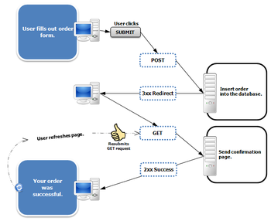
Post-redirect-Get
PRG is a pattern, and easy to implement
[HttpGet]
public IActionResult Create()
{
return View(new ProductModel());
}
[HttpPost]
public IActionResult Create(ProductModel productModel)
{
if (!ModelState.IsValid)
{
return View(productModel);
}
// Do magic with productModel
return RedirectToAction("Details", { id });
}

Slide 36

Areas

Slide 37
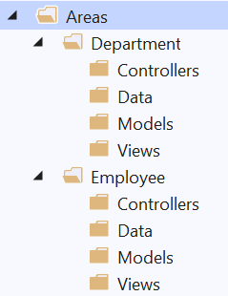
Areas
Some applications can have a large number of components
We can partition Web applications into smaller units (Areas)
An Area is effectively an MVC structure inside an application
Example: large e-commerce application
Store, users, blog, forum, administration
To use areas you should change the default route template:
routes.MapRoute(
name: "areas",
template: "{area:exists}/{controller=Home}/{action=Index}/{id?}"
);

Slide 38
Performance

Slide 39

Performance
Performance is an important topic in Web app development
Slow-loading discomforts your clients and drives them elsewhere
There is no magic functionality which optimizes your app
There are many tips, though, on how to speed up your app

Slide 40
Performance Tips (1)
Measure everything (Application Insights, dotTrace)
Gather diagnostics for your application
Localize which are the slow components of your application
Analyze what slows down these components
Order and prioritize the most malicious slow-pokes
Pick the low-hanging fruit first
Once you've determined the slowest component, prioritize it

Slide 41
Performance Tips (2)
Enable Compression
HTTP Protocol is not particularly efficient
You can enable Response Compression to increase app efficiency
ConfigureServices: services.AddResponseCompression();
Configure: app.UseResponseCompression();
Reduce HTTP Requests
HTTP Communication is quite slow
Reduce amount of HTTP Requests needed for each functionality
Use sprites for images and fonts instead of images

Slide 42
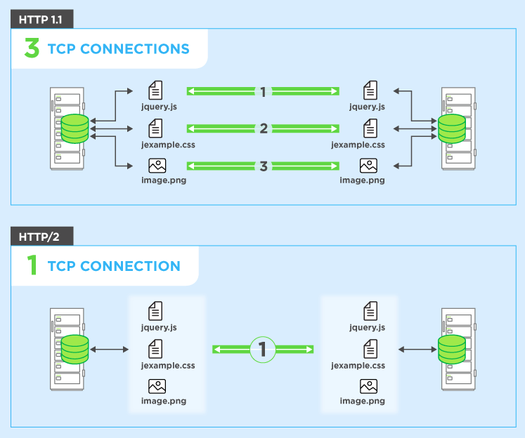
Performance Tips (3)
HTTP/2 over SSL (enabled by default)
Binary protocol, Compression of headers
Request multiplexing, HTTP 1.1 compatible
Minify your files (bundleconfig.json)
Compression is a great tool
Your third-party resources are unnecessarily slowing your app
You can minify them in order to reduce the data traffic

Slide 43
Performance Tips (4)
Load CSS First
CSS Content must be loaded first, preferably in the head section
Browsers tend to do unnecessary actions when rendering pages
Load JS Last
Pages need to be rendered as quickly as possible
JavaScript is not particularly needed for the rendering of pages
Of course, this is only applicable to non-heavy JavaScript sites

Slide 44
Performance Tips (5)
Cache your pages
There is a lot of static, unchangeable content on web app pages
The process of its slow retrieval does not need to be repeated
Content Delivery Network (CDN)
CDN outsources a bit of work from your application
There are plenty of CDNs closely-located to your clients
CDNs are a preferred resource in Production Environment

Slide 45
SEO
Search Engine Optimization

Slide 46

Search Engine Optimization (SEO)
Search Engine Optimization is very important in web apps
Common users tend to use Google/Bing to look for services
There are ways to boost your place in the results of SEs
There are several simple tips you can follow:
Unique content, external links from trustworthy sites
Make your application crawlable and fast
Make your URLs meaningful
Unique and relevant title and description with keywords

Slide 47

GDPR

Slide 48
GDPR
General Data Protection Regulation (GDPR) is a regulation in EU law
Addresses data protection and privacy of individuals within the EU
It also addresses export of personal data outside of the EU
GDPR aims to:
Provide individuals with more control over their personal data
Simplify the regulatory environment for international businesses
ASP.NET Core provides APIs to help meet some GDPR requirements
There is also a sample app in GitHub here

Slide 49
GDPR
There are several individual rights you must provide your clients
Right to be informed – inform your clients how you use their personal data
Right of access – if a client requests their data, you must provide it
Right to rectification – allow clients to correct inaccurate personal data
Right to erasure – provide clients with the ability to erase their data
Right to restrict processing – allow clients to block processing of their data
Right to portability – allow clients to obtain and reuse their data
Right to object – allow clients to object to the use of their personal data
Rights related to automatic decision making, including profiling

Slide 50

Summary
WebHost and WebApplication
Logging
Cache
Sessions
TempData
Areas
Performance
SEO
GDPR
…
…
…

Slide 51
Questions?
Notes:
51

Slide 52













SoftUni Diamond Partners

Slide 53

Educational Partners

Slide 54
Trainings @ Software University (SoftUni)
Software University – High-Quality Education, Profession and Job for Software Developers
softuni.bg, softuni.org
Software University Foundation
softuni.foundation
Software University @ Facebook
facebook.com/SoftwareUniversity
Software University Forums
forum.softuni.bg
Notes:
54

Slide 55

License
This course (slides, examples, demos, exercises, homework, documents, videos and other assets) is copyrighted content
Unauthorized copy, reproduction or use is illegal
© SoftUni – https://softuni.org
© Software University – https://softuni.bg
Notes:
55

